Slide 1
Dimensionality Reduction
Shen Bingquan <sbingqua@dso.org.sg>
National University of Singapore :: School of Engineering :: Engineering Science Programme

Slide 2
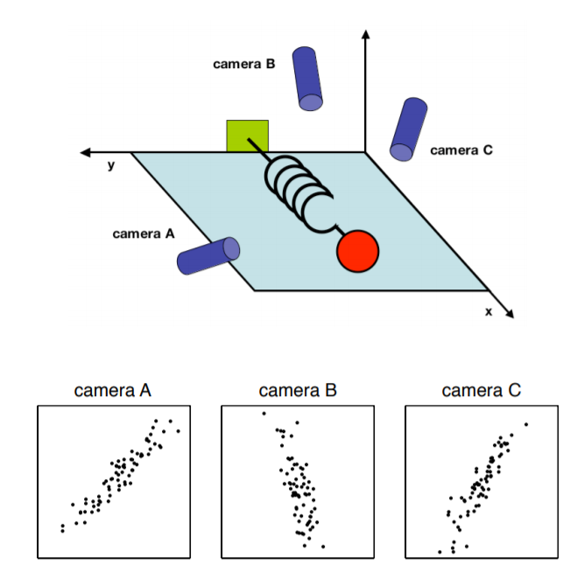
Toy Example
Measuring a ball’s position in a three-dimensional space.
Shlens, J. (2014). A tutorial on principal component analysis. arXiv preprint arXiv:1404.1100.

Slide 3
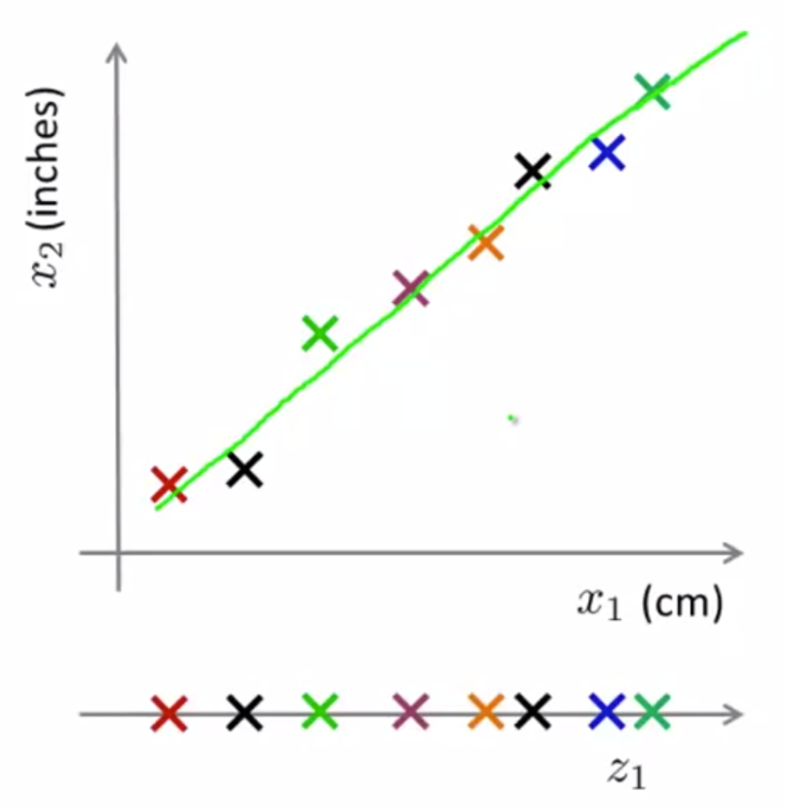
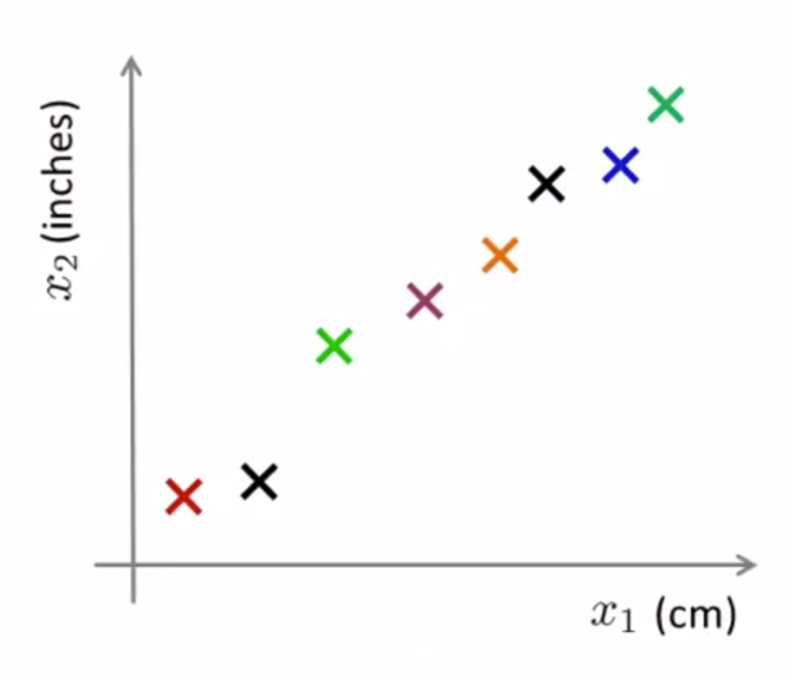
Why Dimensionality Reduction?
Highly correlated features are redundant.
https://www.coursera.org/lecture/machine-learning/motivation-i-data-compression-0EJ6A

Slide 4
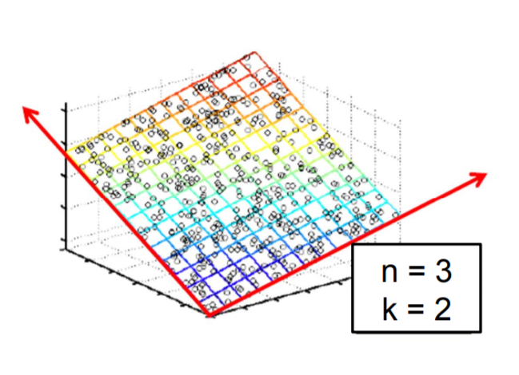
Why Dimensionality Reduction?
Data compression
Easier learning
Speed up learning
Improve model performance
Data visualization
z₂
z₁

Slide 5
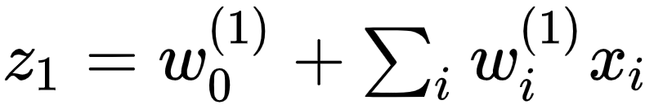

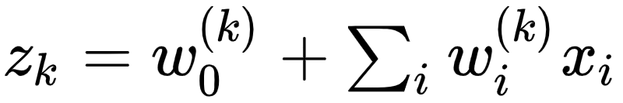
Lower Dimensional Projections
Obtain new feature vector by transforming the original features [x₁, … ,x_{n}]
New features are linear combinations of old ones
Reduces dimensions when k < n
In general not invertible - cannot go from z back to x
https://people.csail.mit.edu/dsontag/courses/ml16/slides/lecture23.pdf

Slide 6
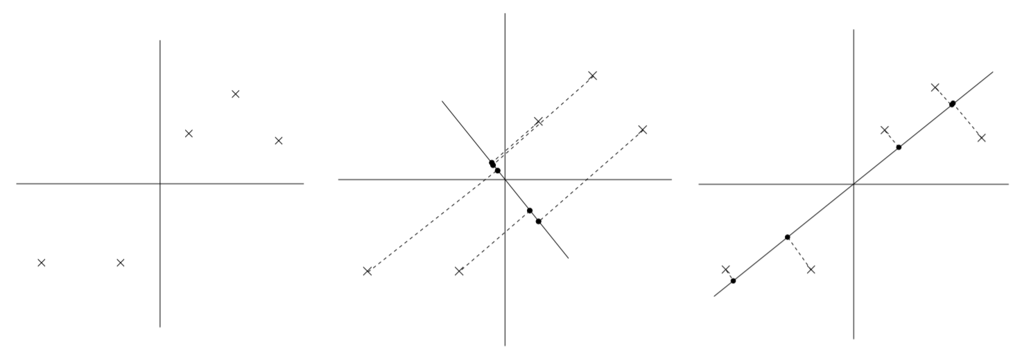
Which Projection is Better?
Minimize projection error
Maximize variance of projection
http://cs229.stanford.edu/notes2020spring/cs229-notes10.pdf

Slide 7
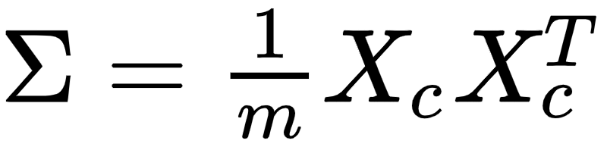
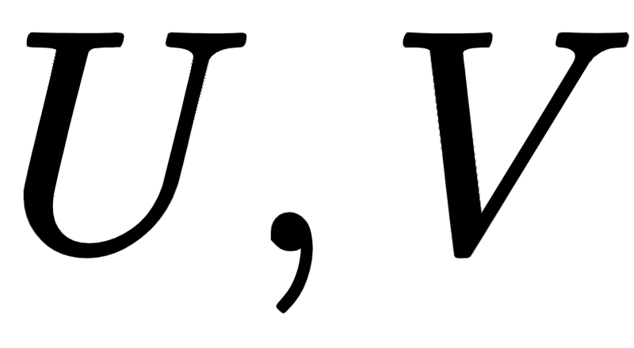
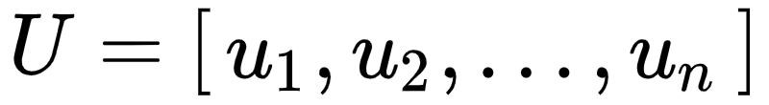


Basic Principal Component Analysis (PCA) Algorithm
Given training set:
Data preprocessing
Feature scaling / mean normalization
Compute Covariance Matrix
Find eigen vectors and values
Principle components: k eigen vectors with highest eigen values
$$\{x^{\left(i\right)};i=1 , …,m\}$$
$$x_{j}^{(i)}=\frac{x_{j}^{\left(i\right)}−μ_{j}}{σ_{j}}$$
Top k

Slide 8
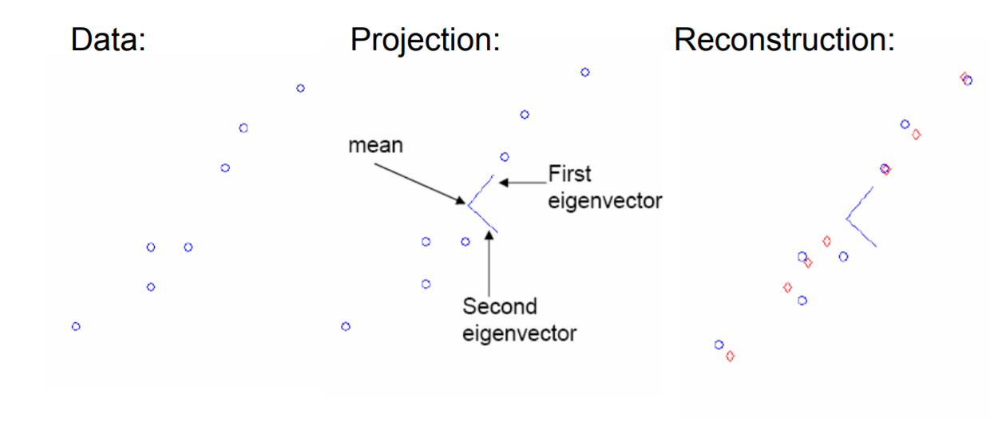
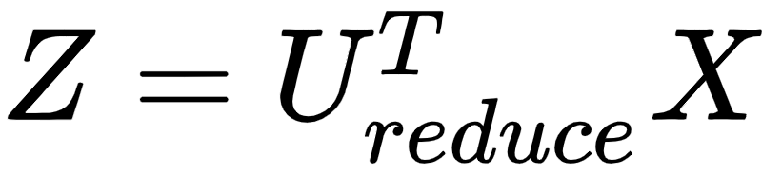
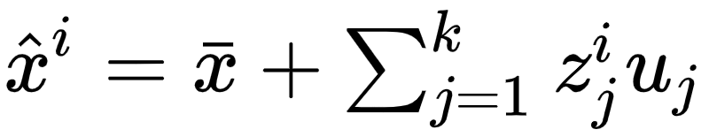
PCA Example
<k x 1> <k x n> <n x 1>
https://people.csail.mit.edu/dsontag/courses/ml16/slides/lecture23.pdf

Slide 9
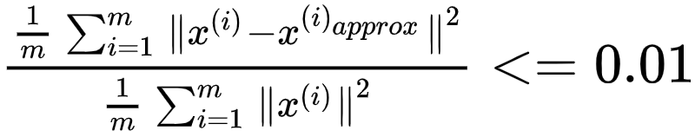
Choosing k (number of principal components)
Chose k to be smallest value so that
Average square projection error
Total Variation in Data

Slide 10

Singular Value Decomposition (SVD)
X: data matrix, one row per datapoint
S: singular value matrix (diagonal matrix)
Z: weight matrix
S times Z gives coordinates of x_{i} in eigenspace
U^{T}: singular vector matrix
Each row is eigenvector u_{i}
https://people.csail.mit.edu/dsontag/courses/ml16/slides/lecture23.pdf
https://web.mit.edu/be.400/www/SVD/Singular_Value_Decomposition.htm

Slide 11
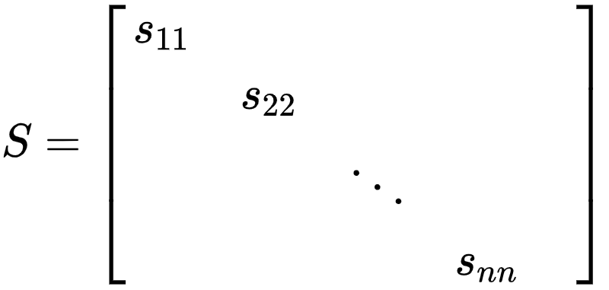
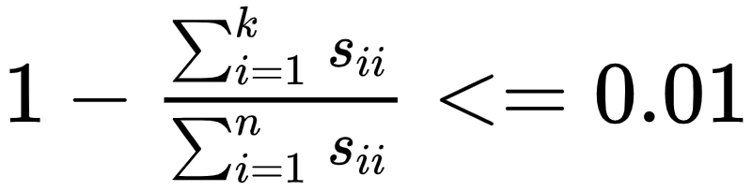
Choosing k (number of principal components)

Slide 12
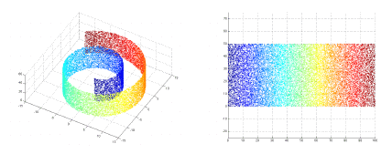
Limitations of PCA
Assumption is that the principal components with highest variance, will be the most useful for solving the machine learning problem.
Only finds linear correlations
Swiss Roll data set

Slide 13
References
https://www.coursera.org/lecture/machine-learning/motivation-i-data-compression-0EJ6A
http://cs229.stanford.edu/notes2020spring/cs229-notes10.pdf
Shlens, J. (2014). A tutorial on principal component analysis. arXiv preprint arXiv:1404.1100.
https://people.csail.mit.edu/dsontag/courses/ml16/slides/lecture23.pdf
https://web.mit.edu/be.400/www/SVD/Singular_Value_Decomposition.htm

